Slide 1
DATASETS FOR MOTION-CAPTURE-BASED
HAND GESTURE RECOGNITION
ANDREW GARDNER - LOUISIANA TECH UNIVERSITY MAY 7, 2017
‘Data Analysis & Data Mining’ Project
CARLO ADORNETTO

Slide 2
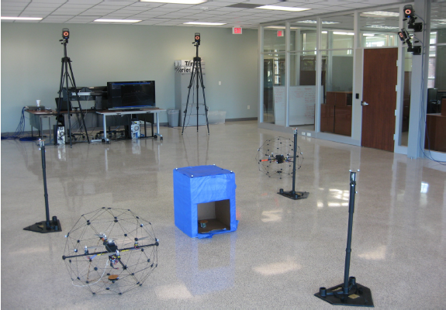
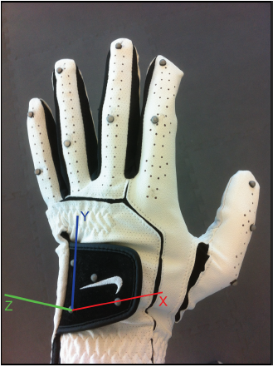
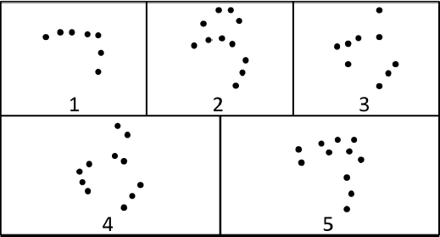
Data was collected with Vicon technology in the Micro-Aerial Vehicle and Sensor Networks (MAVSeN) laboratory - Louisiana Tech University.
Data sources:
A glove with 15 sensori (marker)
4 marker for the relative triaxial space
11 marker (on fingers)
5 postures
Datasets:
Labeled Markers Dataset
Posture Dataset
Gesture Dataset

Slide 3
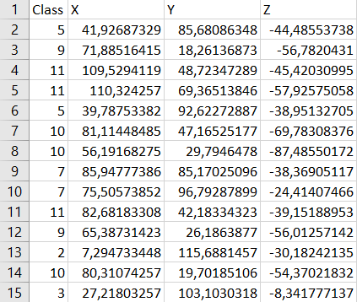
Labeled Marker Dataset
Data:
27338 samples
Class: marker label
X,Y,Z: coordinates w.r.t. the triaxial space
Obbiettivo:
Design a model that is able to classify points in the dataset.
To solve the classification problem, It has been modeled a NEURAL NETWORK, using the Tensorflow-Keras technology.
Labeled Marker Dataset

Slide 4
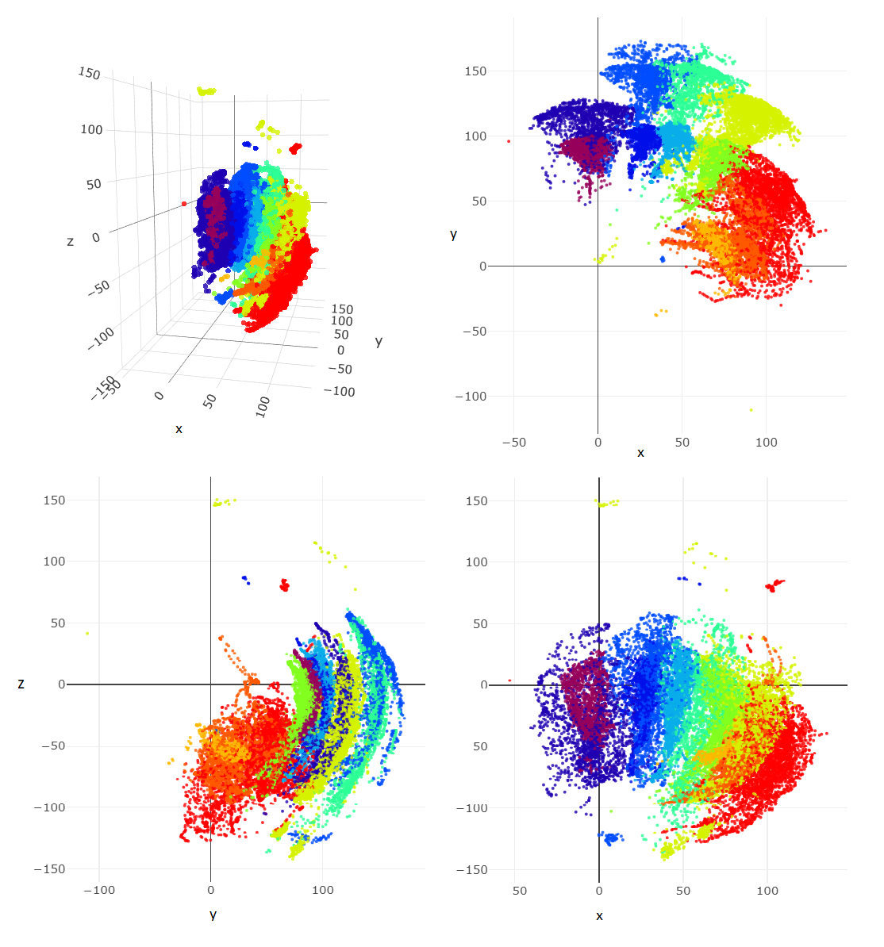
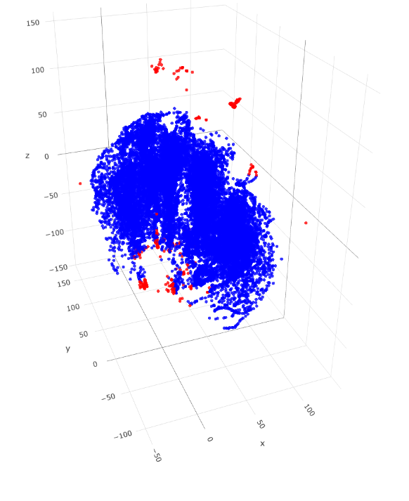
Preprocessing:
Non-linear classification problem
Presence of outliers
“Interquartile range” with 2.5 as coeff.
(383 samples removed).
‘Z-score’ data normalization
Labeled Marker Dataset - Preprocessing

Slide 5
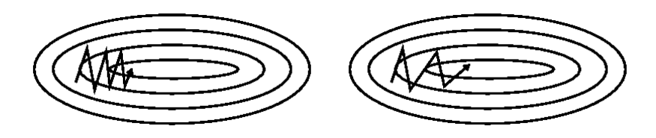
THE MODEL
Le scelte:
tf.keras.model.Sequential() to use Backpropagation
Activation functions:
- ReLu for hidden layers
- Softmax for output layer
Cost function:
- Categorical Cross-entropy
Weights initialization:
- He_normal()
Optimization:
- SGD + Momentum=0.9 + learning_rate_decay
lr = lr * ( 1 / (1+decay+epoch) )
}
Gradient Vanishing
Labeled Marker Dataset - Preprocessing

Slide 6
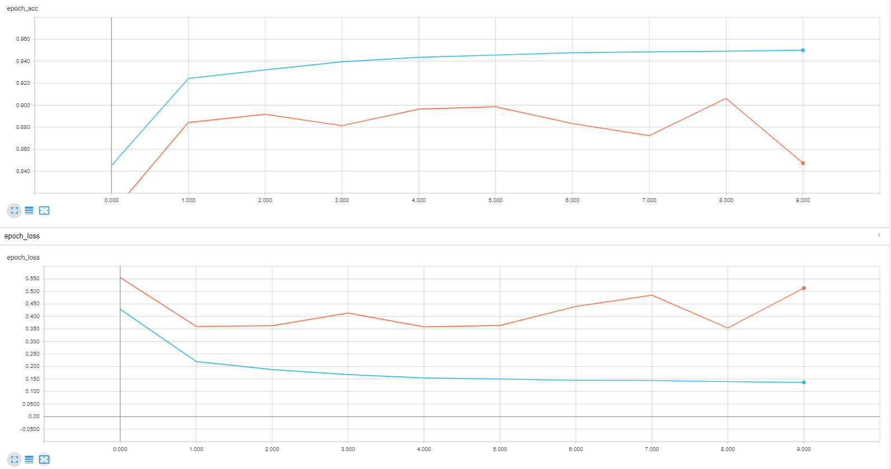
NO decay VS decay

Slide 7
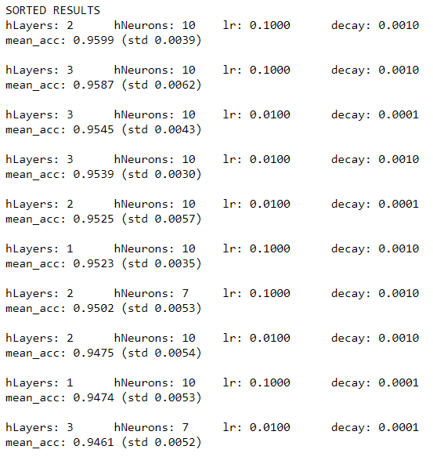
MODEL SELECTION
Layer & Neurons:
Number of hidden layers varied in [1,2,3]
Number of neurons n per layer varied in [7,10]
heuristic : n_input <= n <= n_output
Parameters:
Learning rate varied in [0.1, 0.01]
‘decay’ coefficient varied in [0.001,0.0001]
Empirically identified values.
CROSS-VALIDATION : 10 iterations for each combination -> mean and standard deviation of the accuracy on the validation set.
Labeled Marker Dataset - Model Selection

Slide 8
MODEL EVALUATION
Choice:
2 hidden layer , 10 neurons per layer
Learning rate = 0.1 , decay = 0.001
Bootstrap:
Model has been estimated n times
Evaluation based on the mean accuracy in validation, using the T-student distribution
Results are shown below:
n=10 : 99.9% Confidence Interval [96.164% - 97.267%]
Increasing the number of iteration the interval decrease:
n=30: 99.9% Confidence Interval [96.403% - 96.823%]
Labeled Marker Dataset - Valutazione

Slide 9
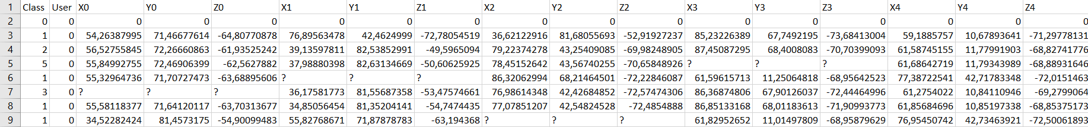
Posture Dataset
Data:
78097 record
Class: posture label
Xi,Yi,Zi: coordinates of the i-th marker
Messy Markers: the i-th marker of a record, doesn’t coincide to the i-th one of another record
Missing: a lot of records has not all the values for markers involved in that posture
Duplicate Markers: for a record there could be present more detection data from the same marker
Goal:
Study clustering algorithms to identify markers and to clear the dataset.
Posture Dataset

Slide 10
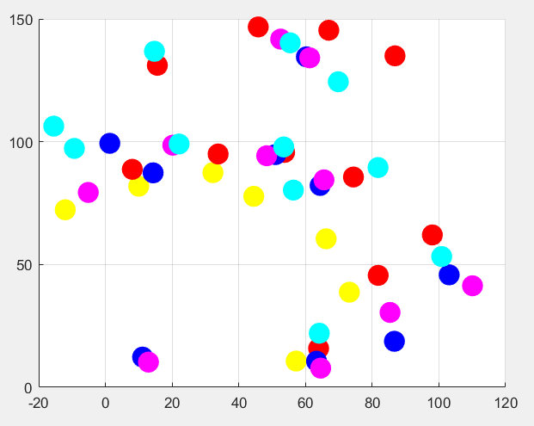
Choices:
Matlab
Interquartile Range
Constrained initialization
Constrained K-means + row constraints
Results:
plot of the obtained k centers for each posture (XY axis)

Slide 11
THANKS

